Slide 1
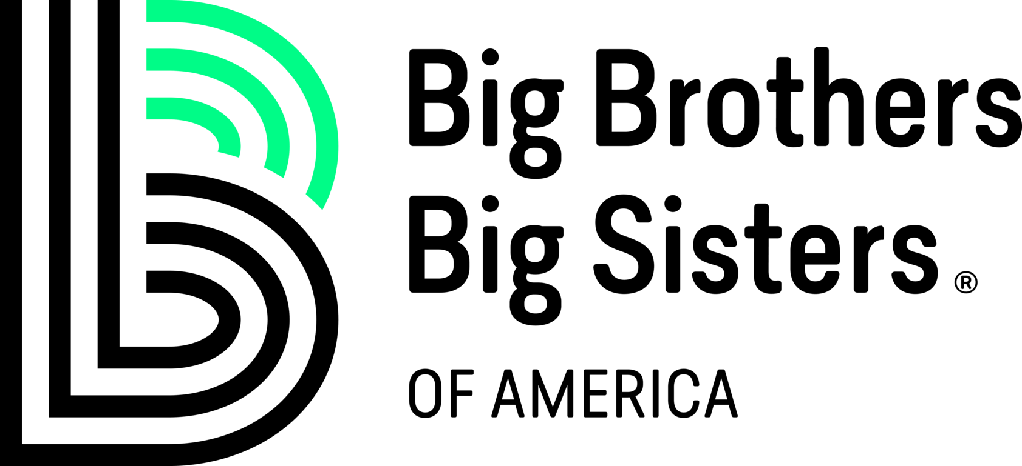
Jaden McCoy, J.R. Vojtech, Trevor Michel, Pronob Kumar, Jacob Gareis

Slide 2

Successful Match Definition
Match that remains active
Graduates or turns 18
Match that lasts over two years
Match Successful Closures within the data

Slide 3
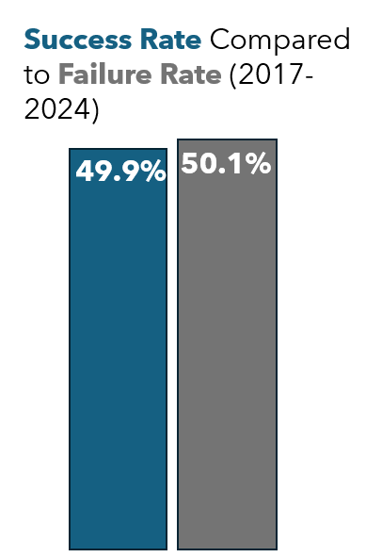
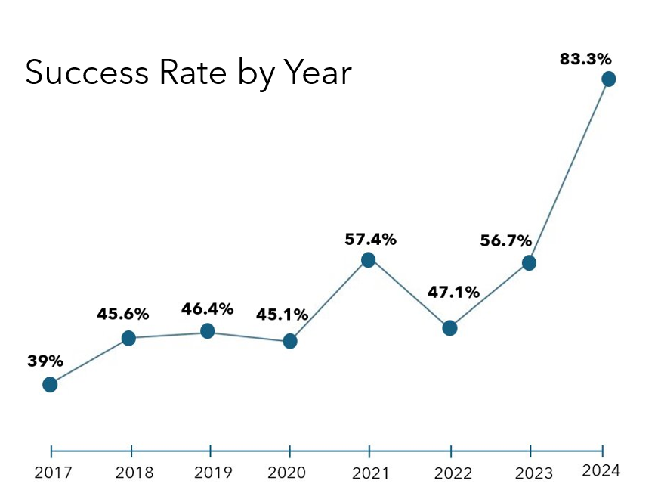
Overall Success Rates

Slide 4
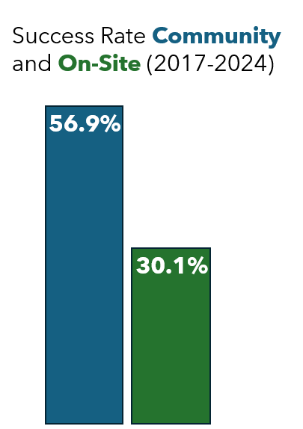
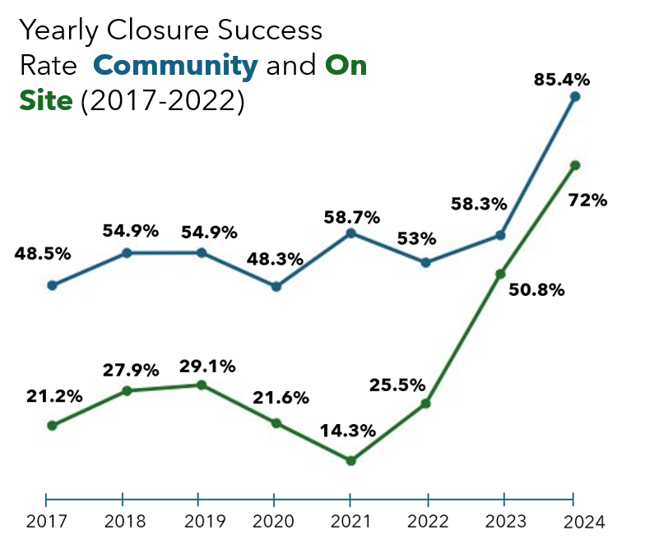
Community and On-Site Success Closure Rates

Slide 5
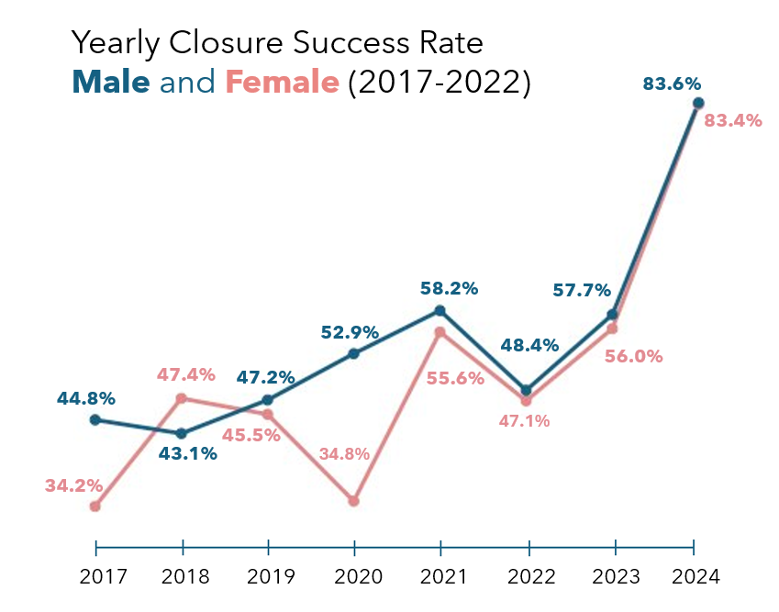

Slide 6
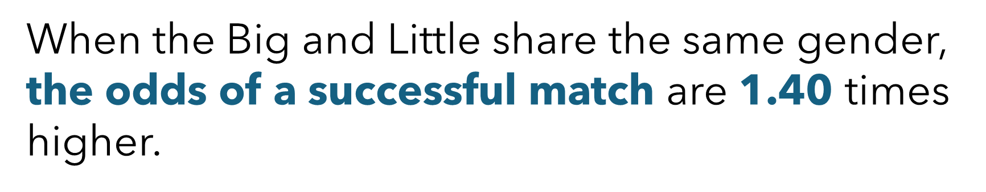
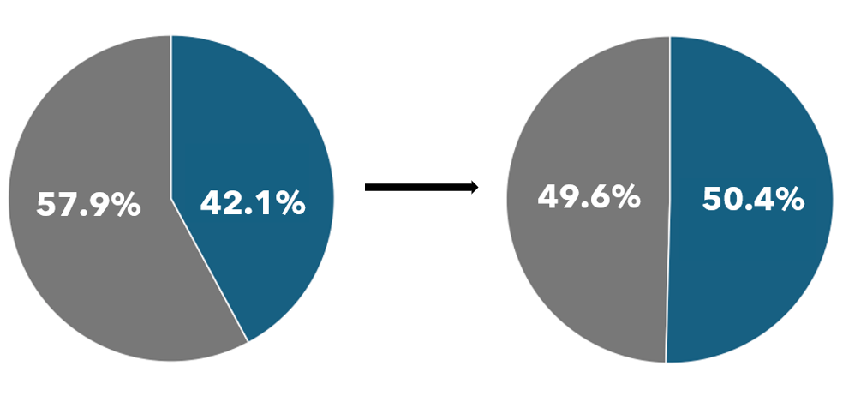
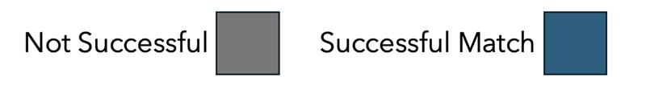
Cross Gender Match
Same Gender Match

Slide 7
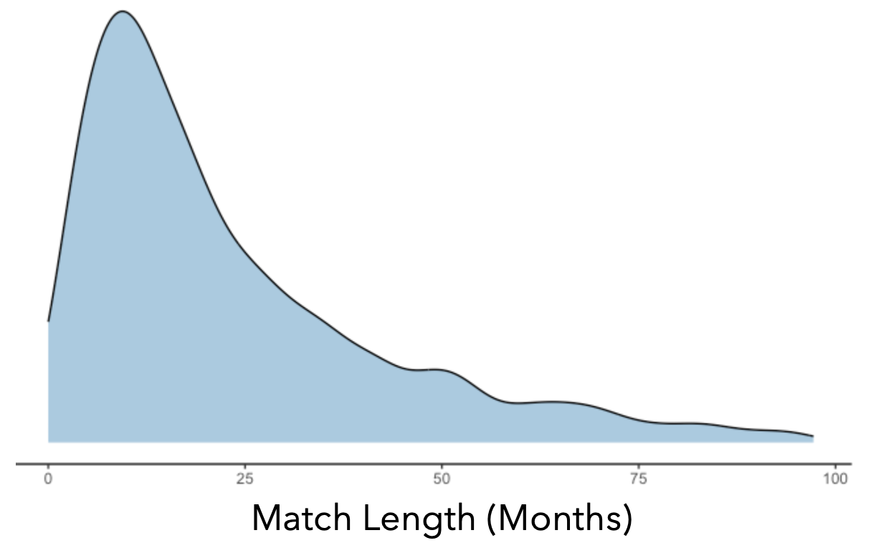
Understanding Match Length
Duration of a Match in Months

Slide 8
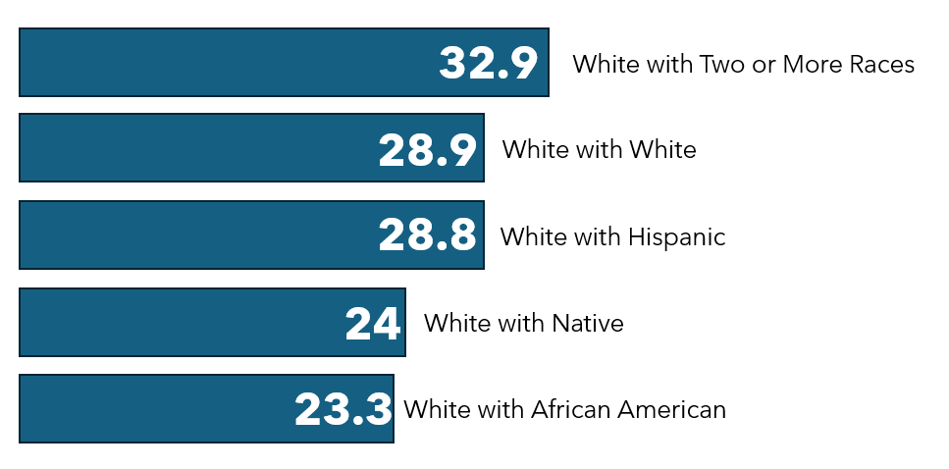
Top 5 Race Pairing by Match Length in Months

Slide 9
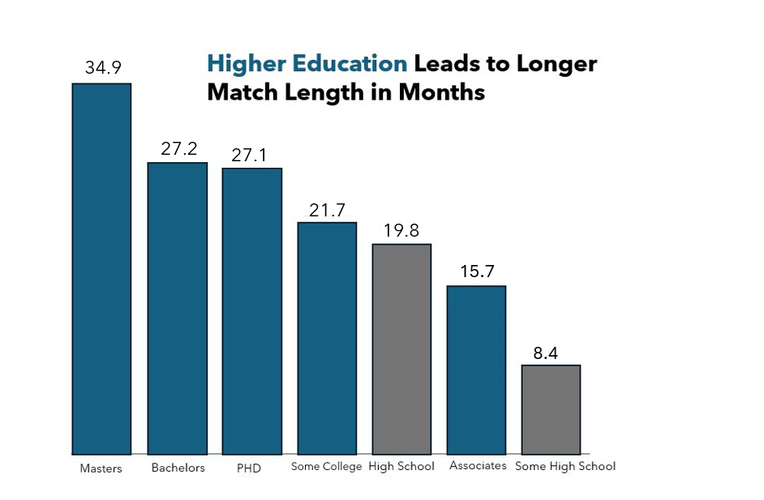

Slide 10
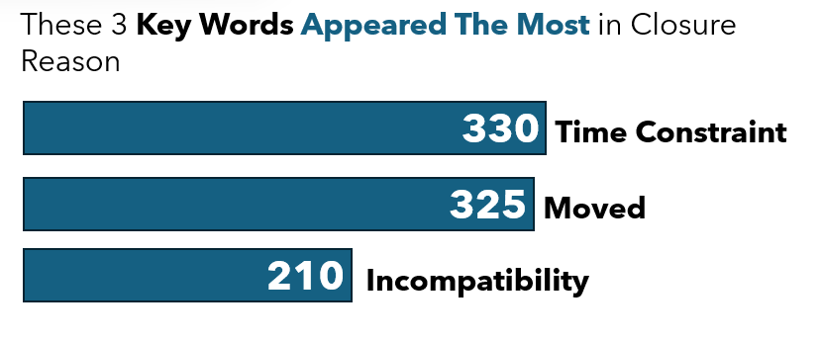

Slide 11
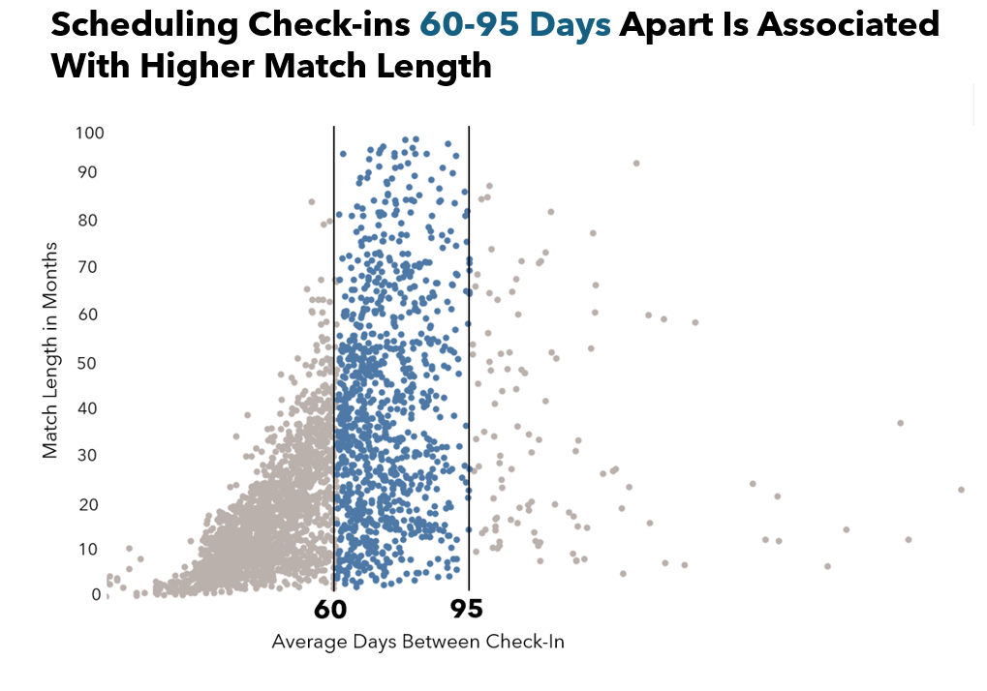

Slide 12
Predicting Match Length
K-fold Random Forest Regressor
Sentiment Analysis
Demographic Factors
U.S. ACS Information

Slide 13
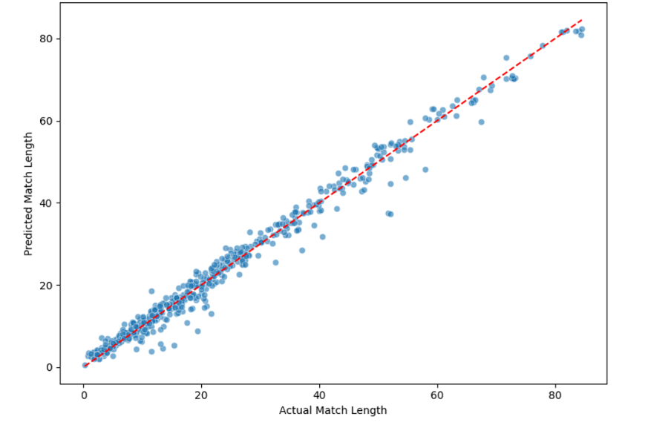
Actual Vs Predicted of Match Length
RMSE of 5 Folds: [2.27, 2.48, 2.29, 2.44, 2.50]
Mean RMSE: 2.34

Slide 14
Language about future goals (e.g., 'high school', 'planning') and self-worth (e.g., 'supporters', 'dignity') is associated with longer match durations.

Slide 15
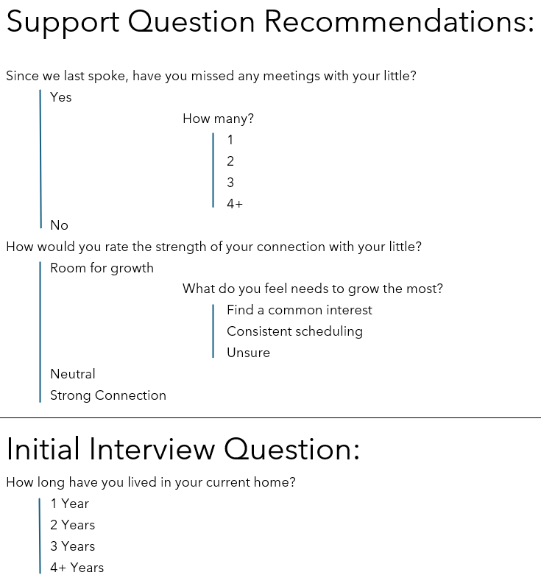

Slide 16
Thank you,
Questions?

Slide 17
Our Contact Information:
      EMAIL
Jaden jadenkmccoy@gmail.com
John jrvojtech@hotmail.com
Trevor tmichel3796@gmail.com
Pronob pronob.kumar@go.winona.edu
Jacob jacob.gareis22@gmail.com

